Slide 1
Week 9 (2) – Review for Final Exam
CST370 – Design & Analysis of Algorithms
Feiling Jia

Slide 2
Review of key topics covered
General test information – Appendix I

Slide 3
Coverage of Topics
  Final exam is comprehensive.
  All the main topics we covered in the class, including the new topic this week: week_9_1 (Dijkstra algorithm)
Three groups of topics:
  Before Midterm I: Week_1_2.ppt to Week_4_3.ppt
  Between Midterm I and Midterm II (review in Appendix II and the corresponding video)
  Between Midterm II and Final Exam: week_8_1.ppt to week_9_1.ppt

Slide 4
Highlight of Topics - Analysis
Running time analysis of algorithms
  Identify basic operations, given code
  Express in Asymptotic notations (big O, etc.)
Recursive algorithms
  Understand what it computes, given code
  Establish recurrence relationship
  Two methods to solve recurrence relationship:
    Back-substitution
    Master Theorem
      T(n) = aT(n/b) + f (n) where f(n) ∈ Θ(n^{d}), d ≥ 0
  Common formula (example):
  n + n/2 + n/4 + … 1 = O(n)

Slide 5
Highlight of Topics - Sorting
Selection Sort
Insertion Sort
Merge Sort
Quick Sort
Heap Sort
O(N²), not depending on input pattern
Worst case: O(N²), Best case (input mostly sorted): O(N)
O(N log(N)), not depending on input pattern
O(N log(N)), not depending on input pattern
Worst case (input sorted): O(N²),
Average: O(N log(N))

Slide 6
Highlight of Topics – Algorithms Design
Selection sort
Sequential search
Brute Force
Decrease-and-conquer
  Decrease by constant
  Decrease by a constant factor
  Decrease by variable size
Divide-and-conquer
Dynamic programming
Greedy
Exponentiation: a^{n} = a * a^{n-1}
Binary search (input sorted)
Searching and insertion in a binary search tree
Coin-Row
Warshall algorithm
Merge sort, Quick sort
Binary tree traversal
Prim
Dijkstra

Slide 7
Highlight of Topics – Example
1. void my_sorting(int arr[], int n)
2. {
3. int i, j, k, temp;
4. i = 0;
5. while (i < n-1)
6. {
7. k = i;
8. j = i+1;
9. while (j < n)
10. {
11. if (arr[j] < arr[k])
12. {
13. k = j;
14. }
15. j = j+1;
16. }
17. temp = arr[k];
18. arr[k] = arr[i];
19. arr[i] = temp;
20. i = i+1;
21. }
22. }
Basic operations: executed most often (typically innermost loop)
Not a basic operation (not executed every time inside the loop)

Slide 8
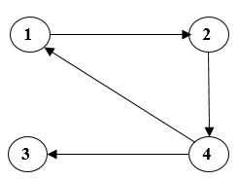
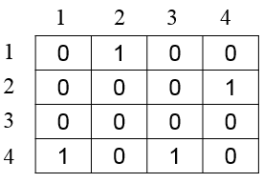
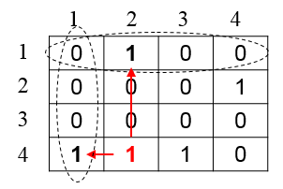
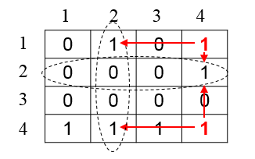
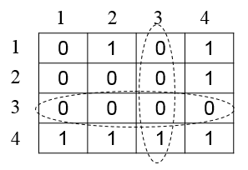
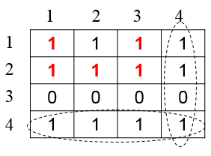
Highlight of Topics – Example
Warshall Algorithm – Compute intermediate matrixes
R^{(k)}[i,j] = R^{(k-1)}[i,j] or (R^{(k-1)}[i,k] and R^{(k-1)}[k,j])
R⁽⁰⁾
R⁽¹⁾
R⁽²⁾
R⁽³⁾
R⁽⁴⁾

Slide 9
Highlight of Topics – Example
Prim’s Algorithm
Start from “a”
c
c
4
4
Add “b”
a
a
1
1
6
V_{t} = a
6
V_{t} = a, b
2
E_{t} =
2
E_{t} = b(a, 2)
d
d
b
3
b
3
c
c
4
4
Add “c”
a
a
1
Add “d”
1
6
6
V_{t} = a, b, d, c
2
2
E_{t} = b(a, 2), d(b,3),
d(c, 1)
d
V_{t} = a, b, d
E_{t} = b(a, 2), d(b,3)
d
b
3
b
3

Slide 10
Highlight of Topics - Dijkstra’s Algorithm
Starting from the vertex a, fill the table
4
b
c
3
5
6
2
a
4
d
e
7
V | a | b | c | d | e
a | 0_{a} | 3_{a} | infinity | 7_{a} | infinity
b |  | 3_{a} | 7_{b} | 5_{b} | Infinity
d |  |  | 7_{b} | 5_{b} | 9_{d}
c |  |  | 7_{b} |  | 9_{d}
e |  |  |  |  | 9_{d}
V | a | b | c | d | e
a | 0_{a}

Slide 11
Highlight of Topics - Puzzle
Don’t forget about puzzles
Clarification of key concepts:
  Best case
  Worst case
  Minimum (not equal to “best case”)
Examples:
  In the best case, minimum number of …
  In the worst case, minimum number of …

Slide 12
Appendix I. General Test Information

Slide 13
General Information (1 of 5)
Date: Feb 29 (Saturday)
Time: 10:00(AM) to 12:30(PM)
Exam Procedure
  It will be the same format as the midterm-I and II.
  Log-in to the iLearn at 10:00(AM) and download the final exam files (one PDF and one Word file).
  Type your answers on the Word file, but use the PDF file for questions, as some contents (particularly the pictures) may not show correctly in Word file (depending on the Word version you use)
  Submit the file on the iLearn before the end of exam.

Slide 14
General Information (2 of 5)
Test time is 2 hours and 30 minutes.
  If you finish the exam early, submit it early and log out early.
This is a closed book exam.
  However, as a reference for the exam, you can prepare “two pages (= total of 4 sides)” cheat sheet.
  The cheat sheet can be typed or hand-written.

Slide 15
General Information (3 of 5)
You can bring a number of blank sheets for the exam and use them to calculate and solve the problems of the exam.
  Because this is an algorithm test, you will need something to scratch.
If possible, type your answers directly in the Word file to increase the readability of your answers.
  However, if it is difficult or too time consuming to type in the Word file, you can write down your answer on a blank paper. Then, take a picture of the paper and insert the picture into the Word file.

Slide 16
General Information (4 of 5)
During the exam, you have to sign into a Zoom session.
  https://csumb.zoom.us/j/7106383260
  Note that we will record the whole exam session.
  Turn on your video, but turn off the audio to avoid noise.
If you have a question during the exam, use "Chat" in Zoom.
  If you talk to me through your computer's microphone, everyone in Zoom will be able to listen.
  I will do my best to answer your question on “Chat” as quickly as possible.

Slide 17
General Information (5 of 5)
When you finish the exam, submit your Word file (and an optional PDF file) on the iLearn.
  Sometimes I can see a broken Word file in a student's submission.
  To avoid this situation, keep your Word file well for use when you need it.
  You can also convert the Word file to a PDF format and submit both Word and PDF files on the iLearn.

Slide 18
<<< Course Instruction >>>
This lecture is over.
  If you have any questions about the final exam, please let me know.
  This is the last PowerPoint file of the whole class.
Thank you for taking this class.
  It’s a great pleasure for me to have the chance to teach you this semester.
  Have a nice summer!

Slide 19
Appendix II. Review for Midterm II
(Key Topics)

Slide 20
Test Coverage
  Key topics covered from week_5_1.ppt to week_7_2.ppt, including
  the puzzles covered in the files.
  the textbook, videos, and Google documents mentioned in the power point files
  Homework (#4, #5)

Slide 21
Highlight of Key Topics
Graph (directed and undirected) algorithms
  Given a graph, you should be able to apply the search algorithms to generate sequence of vertices to be visited
  Breadth-first-search (BFS) – queue based
  Depth-first-search (DFS) – stack based
  O(n) for binary tree (number of edges = n -1)
  Mark array and edge tree
a
b
c
d
e
f
g
h

Slide 22
Highlight of Key Topics
Divide-and-Conquer algorithm design technique
  Apply to solve problems, including puzzles
  Mergesort – O(n*Log(n))
  Quicksort – average O(n*Log(n))
Master theorem
  Apply to solve recurrence relation:
T(n) = aT(n/b) + f (n) where f(n) ∈ Θ(n^{d}), d ≥ 0

Slide 23
Highlight of Key Topics
Quicksort
  Partition of an input list of integers, given a pivot
  Worst case and average case efficiency
  Identify pivot(s), given a partition
  Sample first partition
5 2 3 6 8 13 10 11

Slide 24
Highlight of Key Topics
Binary tree traversal – preorder, inorder, postorder
Binary search tree
Traverse a binary tree or binary search tree
Draw a tree given traverse order (example from homework #5):
A
B
C
D
E
Preorder traversal sequence of a binary search tree is 30, 20, 10, 15, 25, 23, 39, 35, 42

Slide 25
Highlight of Key Topics
Decrease-and-Conquer algorithm design technique
Insertion sort
  Worst case: O(n²)
  Best case (sorted or almost sorted): O(n)
Topological sorting
  DAG (Directed Acyclic Graph)
  Source removal algorithm
    Generate ordered list if it is a DAG
    Detect cycle (if it is not a DAG)

Slide 26
Highlight of Key Topics
Decrease by constant factor
  Binary search – very useful algorithm
    On sorted array – O(log(n))
Binary search tree
AVL tree
  Balance factor
  Identify an AVL tree or not
  Insert a new node and rebalance (if necessary) with one of the 4 types of rotation
  Build an AVL tree with a list of numbers (insert successively)

Slide 27
Highlight of Key Topics
2-3 Tree
  Requirements
  Insert a new node and perform promotions/splitting (if needed) to make the resulting tree a 2-3 tree
  Build a 2-3 tree with a list of numbers (insert successively)
  Do the exercises in the study guides
Heap
  Requirements
  Insert a new node to a heap and heapify if necessary
  Delete the max node from a heap and heapify if necessary
  Do the exercises in the study guides

Slide 28
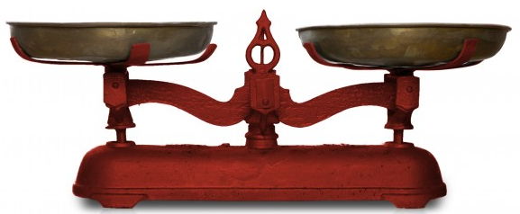
Puzzles
Don’t skip them
Example: Fake Coin Problem
  Suppose you have n coins with one fake coin that is lighter than the rest of the real coins.
    How can you find the fake coin using a balance scale?
    Hint: You must consider both odd and even numbers.

